Slide 1
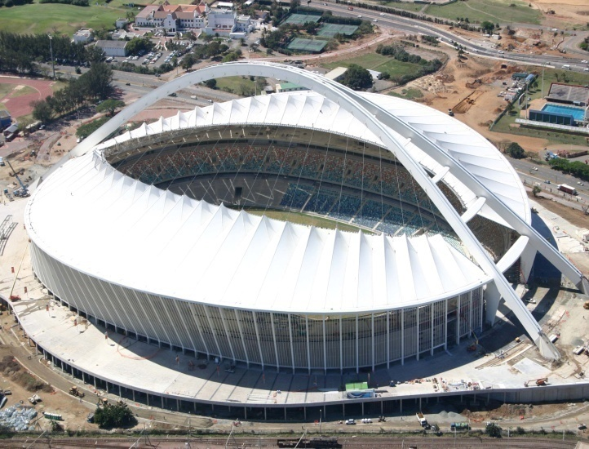

DEVELOPMENT PLANNING ENVIRONMENT AND MANAGEMENT UNIT
PROBLEM BUILDINGS DIVISION
BCO CONVENTION - BITOU MUNICIPALITY
22nd November 2019

Slide 2


Slide 3


Building Inspectorate Functionality
To inspect and manage the erection of Buildings and Building Related Activities in terms of The National Building Regulations and The Building Standards Act No. 103 of 1977 as amended, by:-
Conducting Inspections, Investigations, Issuing Contravention Notices,
Ensuring:
Compliance with applicable legislation is met;
Provide educated, informed decisions;
In order to provide hands on quality service to customers in a manner that regulates, promotes, guides sustainable development and enhances the quality of life.

Slide 4
Legislative Compliance
National Building Regulations and Building Standards Act
To provide for the promotion of uniformity in
the law relating to the erection of buildings
in the areas of jurisdiction of local
authorities;
for the prescribing of building standards;
and for matters connected therewith.

Slide 5
National Building Regulations
Section 4:
No person shall without the prior approval
in writing of the local authority in question, erect any building in respect of which plans and specifications are to be drawn and
submitted in terms of this Act.

Slide 6
Constitution of the Republic of South Africa, 1996 - Chapter 2: Bill of Rights
22. Freedom of trade, occupation and profession:
Every citizen has the right to choose their trade, occupation or profession freely.
The practice of a trade, occupation or profession may be regulated by law.

Slide 7
BUILDING INSPECTORATE CONTRAVENTION WORK FLOW
Identification,
Investigation and serving of notice by BI
Monitor and forward to EO if non-compliant
EO/BI to ensure compliance with Court Order, ie Demolition, remedial work or the like
Court Application for recovery of costs.
EO to issue a “spot summon” (with AG) option to pay or appear in court
EO refers back to BI if non-compliant.
BI issues second notice
EO Issue summons Without an AG
If accused appears in High/Mag court, and an order is granted EO will monitor for compliance with a court order, including obtaining a warrant of arrest for non compliance.
Notes:
Circular overview of the process [Pg 1]

Slide 8
Problem Buildings Division:
  EThekwini Municipality has introduced a strategy that will assist to tackle problem buildings that has been plaguing the inner city with social ills, and transform it into a space for investment and where residents can live securely. The Municipality has committed itself to working with various sectors in eradicating bad buildings by rehabilitation, renovation, rejuvenation, carry out remedial works, or to make way for new developments and attract investors.

Slide 9
Problem Buildings Bylaw:
The PURPOSE of the Ethekwini Problem Buildings Bylaw 2015 (hereinafter referred to as PBB) is “to provide for the identification, control and rehabilitation of problem buildings; to create offences and penalties; and to provide for matters incidental thereto.”
DEFENITION: “problem building” means a building or portion of a building which─
is derelict in appearance or is showing signs of becoming unhealthy, unsanitary, unsightly, or objectionable;
(b) has been abandoned by the owner, or appears to have been abandoned by the owner, regardless of whether or not rates or service charges are being paid;
(c) is overcrowded;
(d) has been hijacked;
(e)has been the subject of one or more written complaints, charges or convictions regarding criminal activities being conducted in the building, as confirmed in writing by a member of the Durban Metropolitan Police Service or the South African Police Service;
(f) is illegally occupied;
(g) has refuse or waste material unlawfully accumulated, dumped, stored or deposited;
(h) has been unlawfully erected or has a part which has been unlawfully erected;
(i) has been changed and its subsequent usage is unauthorised;
(j) is partially completed, or structurally unsound or showing signs thereof, and is or may be a threat or danger to life and property; or
(k) is in contravention of one or more of the Municipality’s by-laws.

Slide 10
INSTITUTIONAL FUNCTIONALITY:
Strategic Workshop resolved that Problem Buildings be managed by DPEM.
The Problem Building Division was introduced within DPEM and organogram approved.
PBSC created, merged with and took over ITRUMP formed in 1997.
The first PBSC met on 24th January 2019.
Advocate commissioned to provide guidance aligned to PBB which resulted in a 73 page doc.
TORs and SOP implemented.

Slide 12
Ownership Categories of Problem Buildings:
Five categories have been identified:
Vacant Council owned derelict buildings;
Occupied Council owned derelict buildings;
Council owned rental stock;
Privately owned (vacant and occupied);
Parastatal/Government Buildings (vacant and occupied).

Slide 13
CATEGORY OF PROBLEM BUILDING
 | DECEASED ESTATES | NO EXECUTORS AND BODY CORPORATE IS DYSFUNCTIONAL | WHEREABOUTS UNKNOWN | DILAPIDATED BUILDINGS | MUNICIPAL ACQUISITIONS AND REFURBISHMENT OF BUILDINGS | PROBLEM BUILDING EVICTIONS
Total number and Item No. on spreadsheet report. | 1 in total. (item no.: 6) | 2 in total. (items 1 and 14) | Nil | 34 in total. (items 1 to 34 = 34/34) | To be finalised as an outcome of interventions. | To be finalised as an outcome of interventions.

Slide 14
STANDARD OPERATING PROCEDURE:
Issue notice of intent,
Issue declaration notice;
Profile building;
Application to High Court;
Implement High Court Order.

Slide 15
SERVICE DELIVERY BUDGET IMPLEMENTATION PLAN:
1.3.2. Issue a refusal, beneficial or certificate of occupancy within 14 days from date of requirement for inspection
1.3.3 Identify, facilitate, profile, monitor and turn around problem buildings. | 1.3.3.1 Profiling of identified problem buildings.
 | 1.3.3.2 Facilitate the service of contravention notices on offending building owners by affected departments.
 | 1.3.3.3 Undertake integrated joint operations on identified problem buildings.
 | 1.3.3.4 Closure, rehabilitation, repurpose and/or re-use of problem buildings.

Slide 16
Rate Code Change
11. ABANDONED, UNAUTHORISED OR ILLEGAL DEVELOPMENT / USE
11.1 Where a property is abandoned, developed or used illegally and in contravention of the Municipality’s bylaws and regulations, the Municipality shall change its category to the Unauthorised or Illegal Development / Use category, notwithstanding any other remedies available via any other Act, Bylaw or Regulation

Slide 17
INCENTIVES:
Advertising wraps on the Problem Building for consideration for approval in terms of the Advertising Policy once promulgated.
Integrated Development Zone tax incentive via SARS.
Economic Development incentive via ECOD.

Slide 18
STATUS and ACTION TAKEN
34 Buildings have been identified and selected;
2 Buildings being processed for High Court Applications (Destruction order);
4 Buildings outstanding for PROFILING;
27 x Privately Owned, 6 x Provincial Owned and
1 x Government owned;
12 Buildings served with contra notices by DPEM;
ABM and BI to continuously monitor ALL buildings per precinct, capture on spread-sheet, action non-compliance and ensure resolution in order to reduce and/or eradicate Problem Buildings.

Slide 19
Challenges with Privately-owned Buildings
Problems when tenants are rental-paying but owner reneging on maintenance & law finds it incumbent on Council to provide alternate accommodation
Private evictions ending up prejudicing Council in terms of alternative accommodation being imposed for council to provide ( e.g. Imperial hotel)

Slide 20
Proactive prevention of Problem Buildings
  Core departments must ensure sufficient resources are in place in order to undertake daily routine work and ensure compliance in line with specific mandates.
  Revenue Management to trigger Legal recovery process for arrear revenue over a specific amount and to alert PBSC to undertake investigations.
  PBSC to be alerted early by line depts to intervene as a collective for all affected departments if aligned to a Problem Building.

Slide 21
Early identification/prevention of
Problem Buildings
  Ensure adequate funding in place for regular maintenance of Municipal Buildings.
  Facilitate re-use, re-purpose Municipal buildings.
  High Court applications for:
  (1) Appointment of Administrator for defunct BCs,
  (2) Expropriation,
  (3) Demolition,
  (4) Eviction and rehabilitation.

Slide 22
How will turning around a Problem Building benefit the Community?
Create a safer suburb/street.
Assist those who previously illegally occupied the building to relocate.
Stabilize the market value of properties in the area by turning around Problem Buildings.

Slide 23
STAGES TO RESTORE & REJUVINATE PROBLEM BUILDINGS

Slide 24
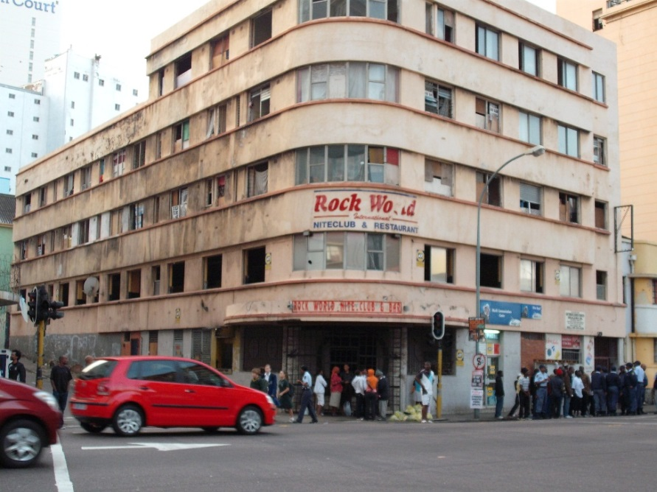
Tong Lok = 562 Mahatma Gandhi St

Slide 25
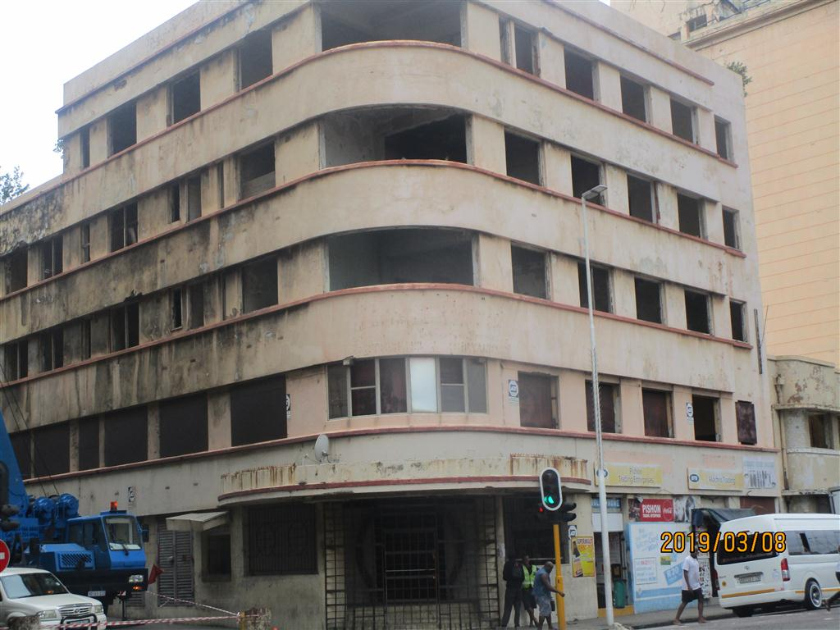
Tong Lok = 562 Mahatma Gandhi St
Dilapidated, Unmaintained,
Dysfunctional Body Corp. 4. Abandoned
Total rates outstanding =
R986 000.
June 2019 - Legal process
of approaching High
Court for the appointment
of a judicial administrator,
in order to attempt to
rehabilitate the building.
Failure of the latter, a
High Court Application
will be sought to
Expropriate the property.
Thereafter an expression
of interest will be advertised
and sale via a public tender
process.

Slide 26
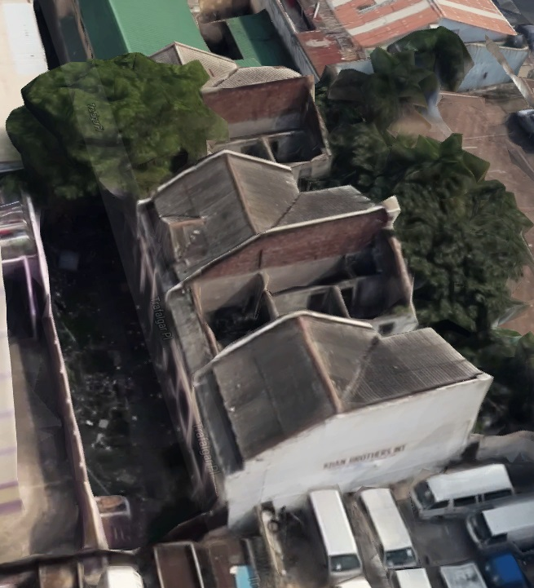
4 Trafalgar Lane
Dilapidated and
Dangerous.
Demolition commenced on 16th July 2019.
Completed on 30 October
2019

Slide 27
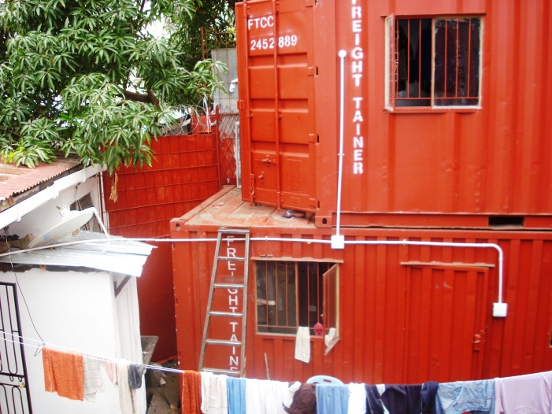
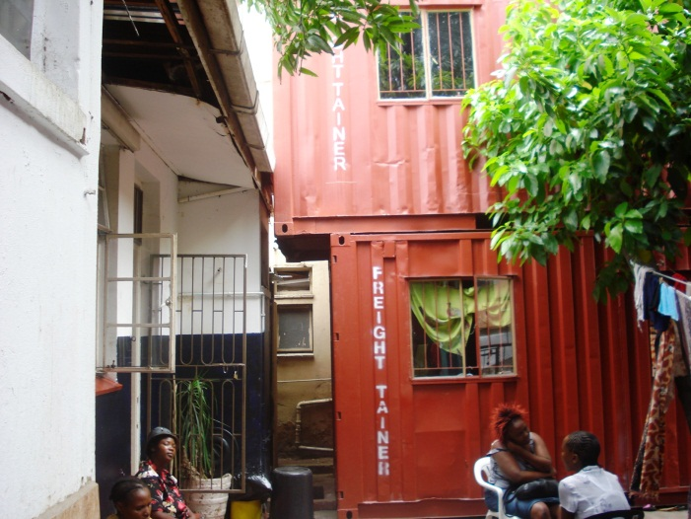
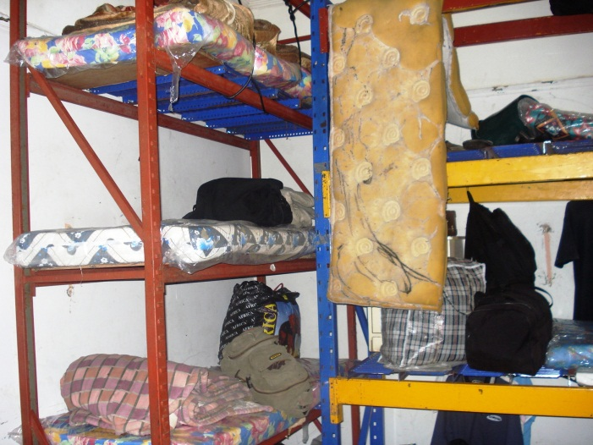
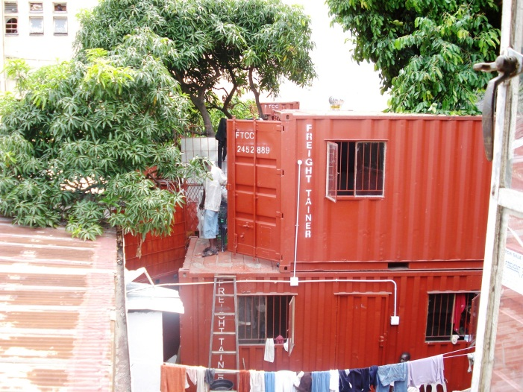
28 Carlisle Street

Slide 28
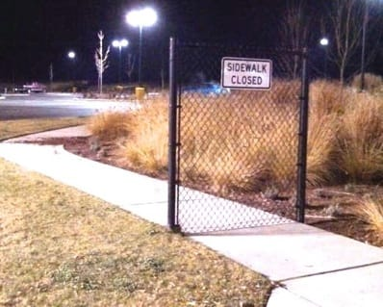

Slide 29
Ngiyabonga !!!
Thank You!!!
Dankie !!!

